Slide 1


Building a Web App for Data Exploration with Smart Mapping
Esri Developer Summit
March 8–11, 2016 | Palm Springs, CA
Kristian Ekenes and Jeremy Bartley
Notes:
[KRISTIAN]

Slide 2
Sample App
Seattle Demographics

Slide 3

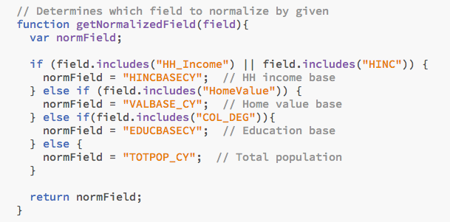


Slide 4
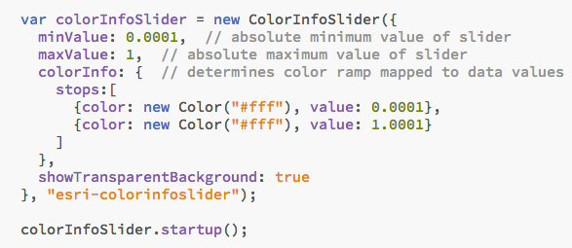

Slide 5
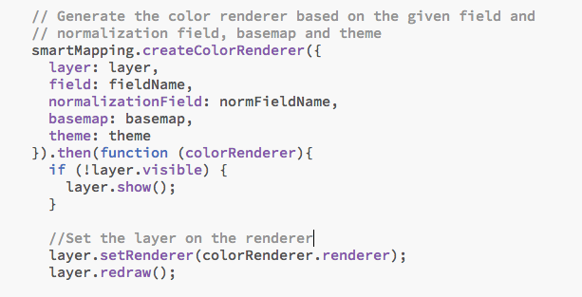
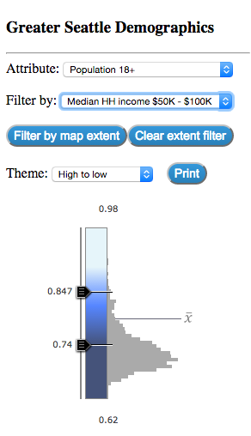

Slide 6
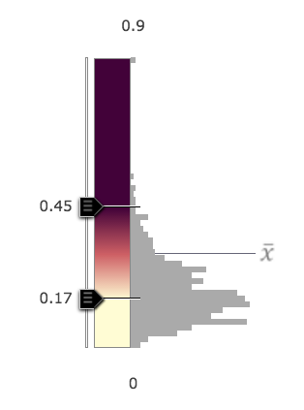
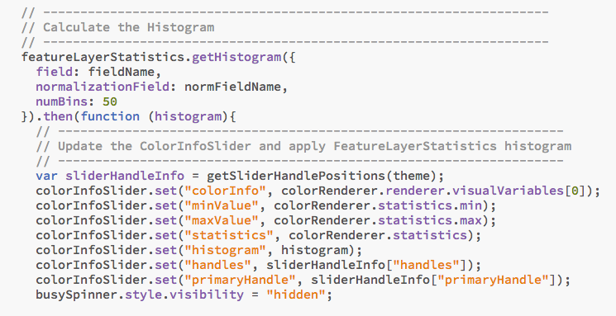

Slide 7
Resources
Documentation
https://developers.arcgis.com/javascript/jsapi/esri.renderers.smartmapping-amd.html
https://developers.arcgis.com/javascript/jsapi/featurelayerstatistics-amd.html
https://developers.arcgis.com/javascript/jsapi/colorinfoslider-amd.html
https://developers.arcgis.com/javascript/jsapi/sizeinfoslider-amd.html
Demos/samples
https://github.com/ekenes/conferences/tree/master/ds-2016/smart-mapping
https://github.com/ekenes/esri-js-samples/tree/master/smart-mapping

Slide 8




